Slide 1
Helm Charts

Slide 2
Agenda
What is helm?
What are helm charts?
Why use helm charts?
The Chart File Structure
Helm Commands
Deploy an application using kubernetes helm

Slide 3
Helm
Helm is a open source tool for packaging, install and update — Kubernetes Resources.
Helm == Linux “yum” , “apt” package manager
It allows describing the application structure through convenient helm-charts and managing it with simple commands.

Slide 4
Helm Charts
“Chart”is a Helm’s packaging format
Chart is a collection of files (related set of Kube resources)
A Chart is a folder which contains: chart (metadata), template(manifest of Kubernetes Resource), values (CPU, RAM, Docker Image name)

Slide 5
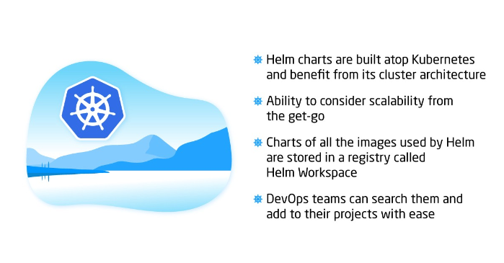
Helm benefits

Slide 6
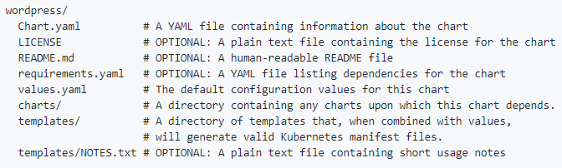
The Chart File Structure
A chart is organized as a collection of files inside of a directory.

Slide 7
The Chart.yaml File
apiVersion: The chart API version, always "v1" (required)
name: The name of the chart (required)
version: A SemVer 2 version (required)
kubeVersion: A SemVer range of compatible Kubernetes versions (optional)
description: A single-sentence description of this project (optional)
keywords:
- A list of keywords about this project (optional)
home: The URL of this project's home page (optional)
sources:
- A list of URLs to source code for this project (optional)

Slide 8
The Chart.yaml File (cont…)
maintainers: # (optional)
- name: The maintainer's name (required for each maintainer)
email: The maintainer's email (optional for each maintainer)
url: A URL for the maintainer (optional for each maintainer)
engine: gotpl # The name of the template engine (optional, defaults to gotpl)
icon: A URL to an SVG or PNG image to be used as an icon (optional).
appVersion: The version of the app that this contains (optional). This needn't be SemVer.
deprecated: Whether this chart is deprecated (optional, boolean)
tillerVersion: The version of Tiller that this chart requires. This should be expressed as a SemVer range: ">2.0.0" (optional)

Slide 9
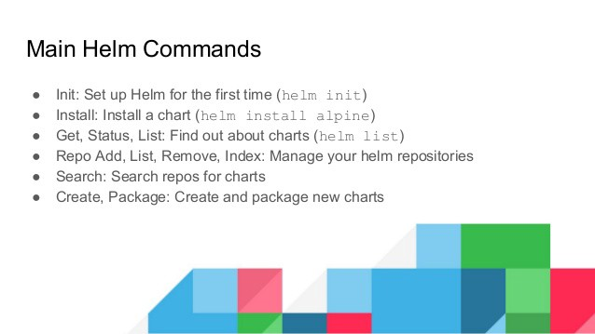
Helm Commands

Slide 10
Demo

Slide 11
Thank You

